Slide 1




Smart Contract Development (Solidity)
Sarang Parikh
Order of Satoshi | nmit.ac.in/blockchain
Notes:
http://www3.weforum.org/docs/WEF_The_future_of_financial_infrastructure.pdf

Slide 2
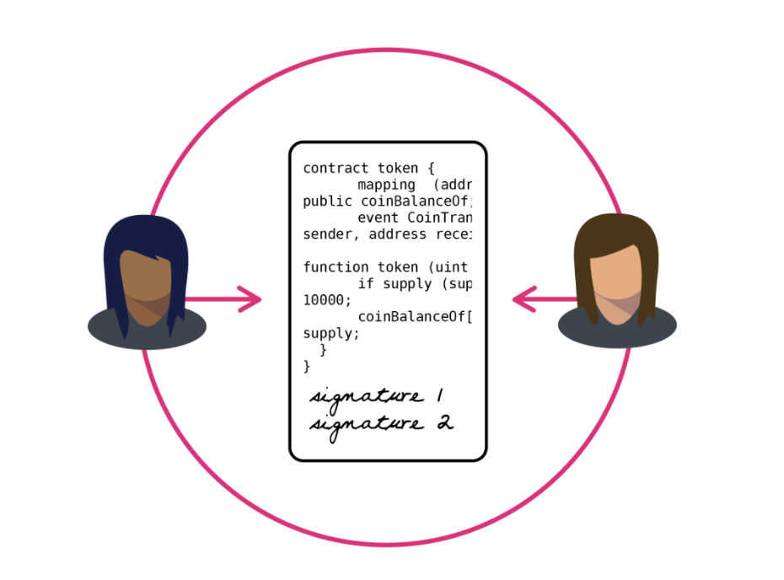
Smart Contract Development
What are Smart Contracts?
A smart contract is a set of computer code between two or more parties that run on the top of a blockchain and constitutes of a set of rules which are agreed upon by the involved parties. Upon execution, if these set of pre-defined rules are met, the smart contract executes itself to produce the output. This piece of code allows decentralized automation by facilitating, verifying, and enforcing the conditions of an underlying agreement. Smart contracts allow you to exchange anything of value including money, shares, property etc., in a transparent manner eliminating the need for a middleman and keeping the system conflict-free.

Slide 3
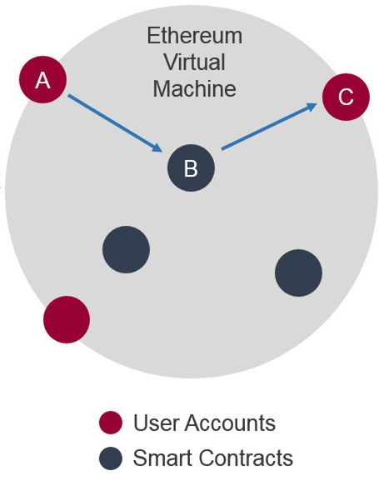
Smart Contract Development
Smart Contracts Execution on Ethereum
Ethereum at the heart of it is the Ethereum Virtual Machine (“EVM”), which can execute code of arbitrary algorithmic complexity. Ethereum is “Turing complete”. Developers can create applications that run on the EVM using friendly programming languages modelled on existing languages like JavaScript and Python.

Slide 4
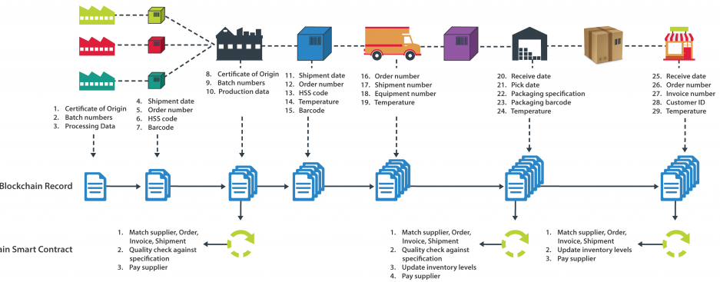
Smart Contract Development
Wait…What are you talking about? So, Example Time
Smart Contract

Slide 5
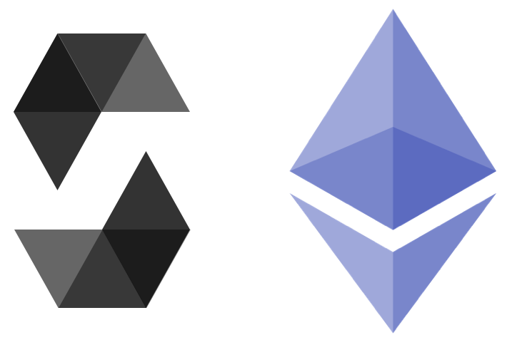
Smart Contract Development
Writing Smart Contracts in Ethereum
Solidity is an object-oriented programming language for writing smart contracts. It is used for implementing smart contracts on various blockchain platforms.
It is by far the most favorite and most used Smart Contract Programming Language
Other Languages:
Viper
Serpent
LLL

Slide 6
Smart Contract Development
Properties of Solidity
Strongly and Statically-typed programming language
Syntax is similar to that of JavaScript
Supports for Custom Data Structures
Supports Inheritance
Supports Abstractions

Slide 7
Smart Contract Development
Solidity Layout
pragma solidity ^0.5.0;
import "<filename>";
…
contract ContractName{
<contract_body>
}

Slide 8
Smart Contract Development
Solidity Types
Integer: uint (for unit256), int (for int256)
uint -> usigned integer
More: uint8, uint128
Boolean: bool -> true or false
Byte Arrays: bytes1, bytes2, … bytes32
Bytes Length: [array].length
Dynamically Sized:
bytes: dynamically array of bytes
string: UTF8 encoded Strings
Bytes and Strings are very Expensive

Slide 9
Smart Contract Development
Solidity Types
Integer: uint (for unit256), int (for int256)
uint -> usigned integer
More: uint8, uint128
Boolean: bool -> true or false
Byte Arrays: bytes1, bytes2, … bytes32
Bytes Length: [array].length
Dynamically Sized:
bytes: dynamically array of bytes
string: UTF8 encoded Strings
Bytes and Strings are very Expensive

Slide 10
Smart Contract Development
Solidity Types
Address: 20 Byte Value Type
Address Fields: balance -> Balance of the Address
transfer -> Transfer Ether
send -> Transfer Ether (Yeah I Know)
call -> Give call to Another Address

Slide 11
Smart Contract Development
Solidity Types
enum: enum Gender{Male, Female, Other}
Mappings(Key Value Pair):
mapping(uint => string) myMapping;
myMapping[0] = “Sarang Parikh”
Struct:
struct Person{
uint age;
string name;
uint countryCode;
}
Person[] people;
people.push(Person(20, “Sarang Parikh”, 91);

Slide 12
Smart Contract Development
Solidity Types of Calls
Local Call: Only Reading, Does not Cost.
Transaction: When Storage is Modified or Data is Changed,
Has Cost
If Transaction run out of GAS, everything is reverted.
Sender should have enough funds.

Slide 13
Smart Contract Development
Solidity Access Specifiers
Public: All can Access
Internal: Only this Contract and It’s derivatives can access it
External: Cannot be accessed from within the Contract, only Externally
Private: Can be accessed only from this Contract
Payable: Function can accept Ether
View: Cannot modify Contract State
Pure: More restrictive than view

Slide 14
Smart Contract Development
Solidity Modifiers
Require: It is used to check a condition and if the condition is false it reverts.
require( age > 18);
Modifiers: These are reusable require statements that can be applied over functions
Modifier votingAge{
require(age > 18);
_;
}
Function vote() votingAge{}

Slide 15
Smart Contract Development
Solidity Functions - General
function funcName(funcParams) accesstype modifiers {
//... Function Body
}
function setValue(uint val) public {
value = val;
}

Slide 16
Smart Contract Development
Solidity Functions - Fallabck
function () external modifiers {
//... Function Body
}
When a function is not found in the Contract Fallback function is called.
Fallback function is just a normal function without function name.
Generally used for storing Ether.

Slide 17
Smart Contract Development
Solidity Functions – Returning Data
function getValue() public view returns(uint){
return value;
}

Slide 18
Smart Contract Development
Solidity Inheritance
contract Owned{
address owner;
modifier isOwned{
require(msg.sender == owner);
_;
}
}
contract MyContract is Owned{
function setValue(uint val) public isOwned {
value = val;
}
}

Slide 19
Smart Contract Development
Solidity Library
pragma solidity ^0.5.0;
library Math{
function add(uint a, uint b) public pure returns(uint){
return (a + b);
}
}
contract LibDemo{
function test(uint a, uint b) public pure returns(uint){
return Math.add(a, b);
}
}

Slide 20
Smart Contract Development
Solidity Interfaces
interface TestContract{
function myAge() external view returns(uint);
}
contract LibDemo is TestContract{
function myAge() public view returns(uint){
return 25;
}
}

Slide 21
Demo Time

